Slide 1
Blockchain Center of excellence
Date: March 12, 2018

Slide 2
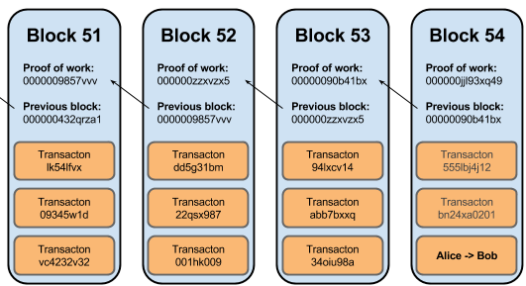
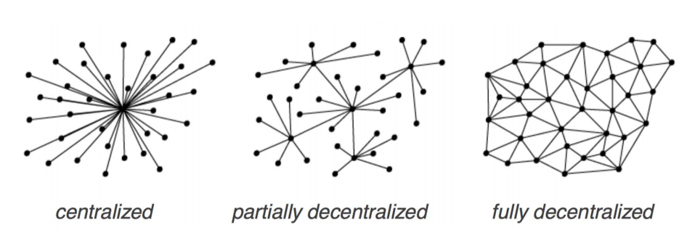
What Is Blockchain Technology?
A Blockchain is a type of distributed ledger, comprised of unchangeable, digitally recorded data(transactions) in packages called blocks. These blocks are linked to each other to form a chain.
Distributed ledgers or decentralised databases are systems that enabled parties who dont fully trust each other to form and maintain consensus about the existence, status and evolution of a set of shared facts spread across multiple sites/countries/institutions (nodes)

Slide 3



What are the major Blockchain Components ?
Decentralized
Validity & Consensus
Cryptographically Secure Authentication
Digital Asset
Unique & Immutable Ledger
Smart Contract

Slide 4

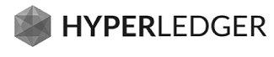

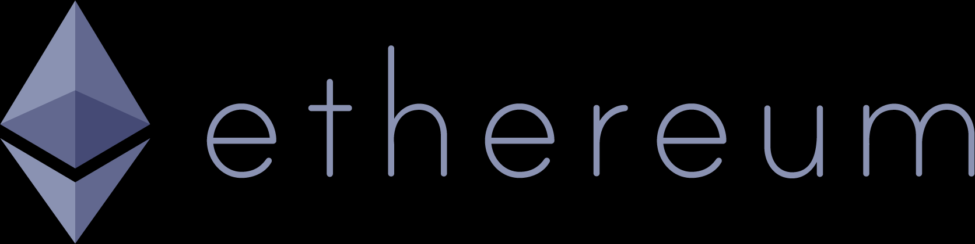


Blockchain Use Cases and POCs
Financial Services
Non-Financial Services
Trade Finance
KYC
Business Identity and Authorizations
Invoicing Settlement Process
Supply Chain
Loyalty - Tokens
Records Management
Private Securities
Syndicated Loans
Development Platforms
Connected Bank – Ripple Integration
PSD2 Integration
Fiat Relay

Slide 5
Trade Finance
DLT Case Study
Date: March 12, 2018

Slide 6
Trade Finance Overview and Challenges
Contract creation and verifications is manual process across all the parties. Exchange of trade data operations still uses traditional methods such as fax and emails. This process is tedious and prone to human error
EXCHANGE OF TRADE DATA
Business Context:
Trade finance signifies financing for trade, and it concerns both domestic and international trade transactions. A trade transaction requires a seller of goods and services as well as a buyer. Various intermediaries such as banks and financial institutions can facilitate these transactions by financing the trade.
Trade finance is the process by which sellers (exporters) and buyers (importers) mitigate trade risk through the use of trusted intermediaries.
Each party across countries operates on different platforms, miscommunication is common and inclination towards fraud is high
MULTIPLE PLATFORMS
Difficult to track the process since it is centralized process for most of the parties involved
STATUS TRACKING
Lack of trust between the parties since it is non transparent process
TRUST & TRANSPARENCY
UNCERTAINTY OF OPERATIONS
Problem Definition:
Uncertainty of delivery of goods to buyer or payment settlement to seller
Can we have a global trade platform which eliminates application/community silos in current trade process and provides trust and transparency.
Platform should be able to reduce delayed timelines and payments process optimizations in current international trade.
No readily available data covering the global blank-intermediated trade finance market. To gauge its size, structure and recent developments, the group therefore relies on a range of sources, drawn in particular from national statistics, SWIFT and ICC trade register
TRADE STATISTICS
Huge efforts and high cost required in consuming paperwork and administrative processes. Shipment of goods is delayed due to multiple checks by intermediaries and numerous communication points
DELAYED TIMELINES

Slide 7
Blockchain Benefits
Blockchain has characteristics and solution abilities that can provide solution to eliminate already mentioned challenges above, how blockchain characteristic are impacting each of the existing concerns and provides the value addition to the business problem is detailed below
Value Drivers | Blockchain Characteristic | Benefits
Global Trade Platform | Shared Ledger | DLT provides a single source of truth / system of records for all the trade participants and eliminates the need to develop individual solutions
Trade Consortium | Private Peer to Peer Network of nodes | Each trade consortium can join the common network owning a node on it, which will encourage large number of trade participants to join this network to have global trade across countries and regions.
Trust and Transparency | DLT based Trust | DLT challenges the need to trust counterparties to fulfill obligations as agreements are codified and executed in a shared, immutable environment.
Automation of Trade Process | Single DLT Platform/ Smart contract | DLT helps to automate the trade process by reducing administrative paperwork and eliminating manual contract creation with tracking and monitoring DLT enables real time status update on DLT reduces time and headcount required to monitor delivery of goods and accelerates end to end trade process Ability to onboard Auditors and Regulators on the platform with other memebers
Payments Processing | Fiat/ Crypto-Currency | Futuristic ability of this solution uses crypto -currency for trade finance payment settlements which eliminates the need for correspondent banks and additional transaction fees.

Slide 8
Solutioning lifecycle and process
Identify the business process getting transformed
Design the transformed business flow
Blockchain Solutioning
Transformed Functional Flow
Designing Solution
Logical Architecture
Deployment Architecture
Smart Contract Identification
Asset
Modelling
Technology Stack
Setup the blockchain platform
Development Tools and frameworks
Forming Consortium/ Peer to peer members
Analysis of the Members Role and permissions
Defining Assets
Asset management including registration and transfer
Defining Consensus
Privacy and Data protection needs
Logical representation of architecture
Converting business rules to smart contracts
Setup and Configurations needs of
the target infrastructure

Slide 9
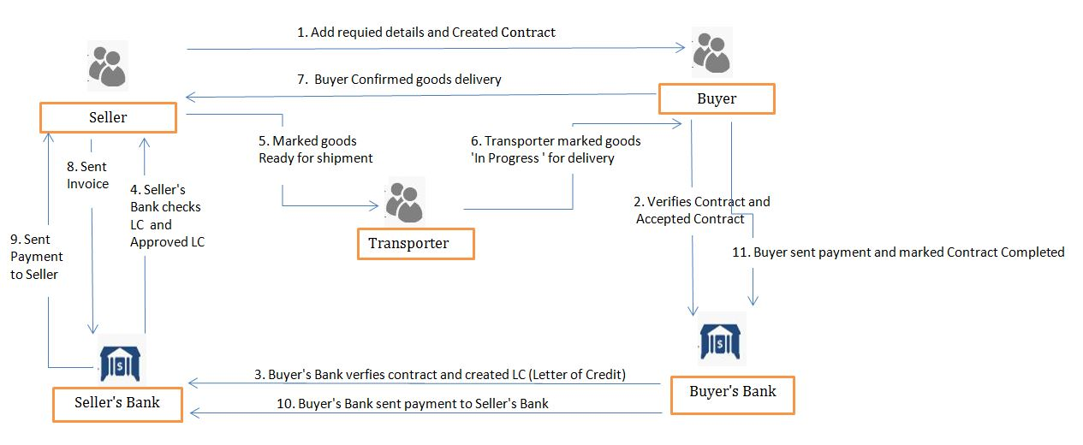
Functional Flow

Slide 10
Blockchain Solution Approach & Logical Architecture
DApps (Decentralized Apps) - User Interface where Network participants can create or update sales contract as per roles and responsibilities.
DApp / Trade Portal UI
Blockchain API Layer - This is integration layer between decentralized application and blockchain network. This layer contains registration, contract management etc. services which will connect DApp with blockchain network.
Registration Services
LC (Guarantee) Mgmt.
Invoices & Billings
Infra Services
Ext. Interfaces
Msg Transform
Listeners/ notifiers
Shipping Mgmt.
Contract Mgmt.
Audit / logging
Error handlers
Excise & customs Mgmt.
Blockchain Network - This is consortium formed by all the participants in trade process who can take part in consensus and will update the contract details on shared ledger.
Blockchain services
Insurers Mgmt.
Chaincode serv.
Blockchain / Transaction Services
Membership services
Secure container
Consensus
P2p protocol
Registration
Identity mgmt.
Payment Gateways
Secure registry
Ledger / storage services
Auditability
Event Streaming
ICC
Blockchain
Network /
Shared Ledger

Slide 11
Deployment Architecture (Hyperledger Fabric 1.0)
The consortium contains Seller, Buyer, Seller’s Bank, Buyer’s Bank, Transporter and Insurer (optional) which will form a blockchain network. Small scale buyers or sellers can be part of this solution without joining or becoming integral part of blockchain network.
6. Insurer (Optional)
node
node
1. Trader (Buyer/Seller)
5. Transporter
Shared Ledger
Smart Contracts
2. Seller’s Bank
node
node
Transaction records of sales contract
Business rules / Conditions for Sales contract and LC creation
node
4. Buyer’s Bank

Slide 12
Smart Contract
A smart contract is business logic that directly controls and validates the transaction on DLT, including asset creation and transfer
Automatic execution of trade process and updating sales contract status is done through smart contracts.
Smart contracts for validating business parameters like, incoterm, Payment Terms, Trade details etc.
Duration limits for the business activities like Payment duration, transport durations, delivery durations to be validated by smart contracts and process and notify the stakeholders accordingly
Smart contract for “lack of conformity”, “non performance” of buyer and seller in association with ICC
Validating norms given in the UCP600 defined by ICC like Payment terms ( LoC, Advance payments, contract payments)

Slide 13
Data Model
Seller
Seller’s Bank
Buyer
Buyer’s Bank
Transporter
Insurer
Sales Contract
Product Details
Delivery Details
Insurance Details
REFERS
UPDATE
SHARED LEDGER
Configurations
Trade Conditions
LC Regulations
Payment Conditions
SLAs
USES
VALIDATE

Slide 14






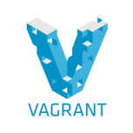



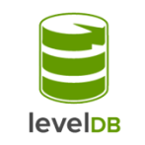

Technology Stack
Technology Stack
User Interface | API | Blockchain Network | Smart Contract | Deployment

Slide 15
Solution Features
Smart programmable contract to automate and optimize trade process
Ability to interact with external systems like payment gateways, excise and customs etc
Ability to accelerate the end to end trade finance process and reduce time required in manual processes
Improves reliability and visibility in cross border trades where participants can track, settle and confirm trade process
Ability to add new participants for global trade across countries and various regions on solution platform
Solution has ability to authenticate agents and financial institutions and reduce fraud
Ability to change smart contract based on change in business rules defined by International Chamber of Commerce
Provides transparency into the location and ownership of the goods

Slide 16
Functional Testing
Functional Testing
System Testing
Integration Testing
Smart Contract Testing
Peer/Node Testing
Unit Testing
Smart Contract Testing
- Simulation of expected and unexpected conditions for every contract
- Testing all possible cominations of Business Logic
Peer / Node Testing
- Verify each node has same ledger copy
- Ordering of transactions in block
- Testing of consensus protocol

Slide 17
Non-Functional Testing
Non-Functional Testing
Performance Testing
Compliance & Security Testing
Resilience and Recovery Testing
Performance Testing
- Block Size which contains transactions
- Latency, Throughput and Scalability of Blockchain Network
Resilience and Recovery Testing
- Validating the ledger after nodes that restarted or rejoined the network sync with other validating peers
- Consensus protocol (PBFT. PoW, PoS) testing
Compliance & Security Testing
- Access permissions testing
- Data privacy on network among nodes
- Expertise in business domain required for compliance and regulatory testing

Slide 18
Testing Tools
Blockchain Platform | Testing Tools
Hyperledger | Hyperledger Composer, Mocha, Chai, Docker Compose
Ethereum | Ethereum Tester, Truffle, Ganache
Corda | Built in feature in framework for writing smart contract/flow tests, Integration and Load testing, Junit

Slide 19
Hyperledger Fabric Platform Features
General Purpose Blockchain
Permissioned, Endorsement Policies, Channels for privacy
Identity Membership provider to manage members and permissions/ Separate Membership and Transaction certificates
Chaincode (smart contracts) to endorse and validate the transactions on the shared ledger
All party consensus at Individual Tranx. level, pluggable (PBFT, Raft, PoW, PoS)
Enterprise grade and modern technology support like Rest / APIs with Docker containers and Cloud
Supported with Oracle services for external integration
Transaction replication on all node Ledgers

Slide 21




RBC Wealth Management Functional Flow
Customer Onboarding and Profiling
Batch job generates Driver File and send it to Symcor
Counsellor / Advisor
Portfolio Mgmnt System
Statement System (SQL DB)
Symcor
Investing financial instruments based on customer objectives
Batch job extract performance and statement data and stores into Statement system
Printing and Mailing of statements to Customers
Wealth/Asset Management Counselling
Batch job stores transaction details into FMC system
Customer
Broadridge System
FMC System
Customer
Third Party Workflow Management System

Slide 22
RBC Wealth Management Pain Points
A wealth and asset manager using different platforms and data architectures causes difficulties in distributing, monitoring and updating third-party models
Automated clearinghouse (ACH) and automated customer account transfer (ACAT) systems take multiple days and involve manual processes using multiple systems and databases
Ongoing monitoring of profiles
Complying with numerous reporting requirements
Huge efforts and cost required for reconciliation of data between multiple platforms

